Slide 1
Name=亚历克上（Alec Mabhiza Chirawu） ID =M202161029

Slide 2


HOLIDAY REPORT
Mission, Vision, Value
SWOT
Introduction
Business strategy
Contents
Summary
Palisade homomophic Encryption

Slide 3
Business strategy
Mission, Vision, Value
Summary
SWOT
Introduction
contents
points
Palisade
Summary and Question
Introduction
lattigo

Slide 4
During the vacation i studied papers and watched lot of seminars related to HE, SHE, FHE.
Seminars i have watched includes :
1) Cryptography Seminar by Professor :Christof Paar
https://www.youtube.com/watch?v=2aHkqB2-46k&list=PL2jrku-ebl3H50FiEPr4erSJiJHURM9BX
2) Palisade - HE
https://www.youtube.com/watch?v=FLGeMd3eiQY
3)
My focus during the holiday was to undestand Lattigo library and palisade library and decide which one to use during my researches.
Mission, Vision, Value
Business strategy
SWOT
Introduction
Summary
Contents

Slide 5



Business strategy
Mission, Vision, Value
SWOT
Vision
Mission
Values
Introduction
Summary
Contents
Connect Ethiopia through state-of-the-art telecom services Provide high quality, innovative and affordable telecom products and services that enhance the development of our nation and ensure high customer satisfaction.
Build reputable brand known for its customers’ consideration
Build its managerial capability and manpower talent that enables ethio- telecom to operate at international level
Support community and environmental development
Lead with vision
Respect
Excellence
Integrity
Accountability
To be a world-class telecom services provider

Slide 6
01
02
Strength
Weakness
Cutting-edge fiber-optics technology
a respected brand name
excellent customer service
a strong sales
Lack of interconnection among countries within the region
Poor traffic localization
Absence of data-driven decision
Mission, Vision, Value
Business strategy
SWOT
Introduction
Summary
Contents

Slide 7
01
02
Opportunities
Threats
Mission, Vision, Value
Business strategy
New technologies
increasing consumer interest
No competition in the country
Government support
Globalization
Shortage of capital and technology
Market access
Shortage of qualified labor force
Government policies
Competition with other countries
SWOT
Introduction
Summary
Contents

Slide 8




Ethio-telecom management has taken its own initiative to develop a three-year strategic business plan to get ready for the upcoming change, reshape the company and lead with business orientation and competitive mindset.
This strategy has been developed with in-house capacity following both deliberate and emergent strategy development approaches to accommodate a changing reality, considering the nature of the business and the ongoing market reform.
Mission, Vision, Value
Business strategy
SWOT
Introduction
Summary
Contents
This plan ensure competitiveness and sustainable growth of the company, this strategy has been developed by considering and reviewing relevant government policies, international best practices and Industry trends
The strategy has been abbreviated as BRIDGE Strategy to symbolize progress, connection, overcoming obstacles, transition, stability and hope, which fits the company situation while making itself ready for different tomorrow, competition, and striving to be a preferred telecom operator.

Slide 9
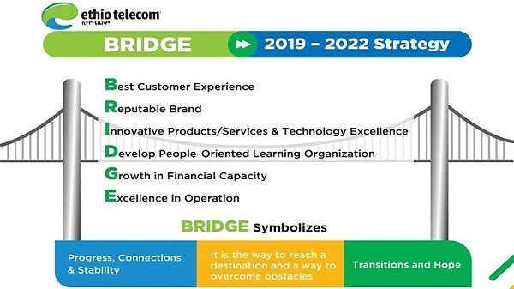
Mission, Vision, Value
Business strategy
SWOT
Introduction
Summary
Contents
Ethio-telecom got more than 11bln increase from the amount collected in the preceding 2018/19 FY, during which the firm garnered 36.3 billion birr.
The company’s total revenue reached 47.7 billion Ethiopian birr, with subscriber numbers reaching 46.2 million in preceding 2019/20 FY.
A 18.4% increase in revenues that is 56.5 billion birr/ in the 2020/21 FY.

Slide 10

Ethio-Telecom has in the past two years embarked on an impressive strategic improvement, the BRIDGE growth strategy, in preparation for the incoming competition. Key areas of reform include improving customer service, employee training, better uptime with upgraded infrastructure through more financing.
Ethio-Telecom is improving fast by capital, customer service excellence, with new innovations and technologies.
Mission, Vision, Value
Business strategy
SWOT
Introduction
Summary
Contents
Do you think BRIDGE business strategy is a good business level strategy? What is the characteristics of good business level strategy?

